Slide 1
1D Convolution

Slide 2
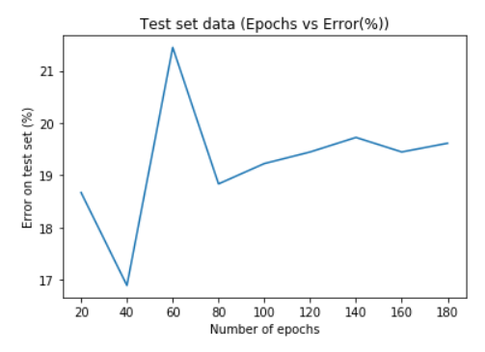
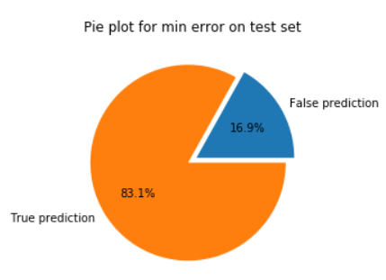
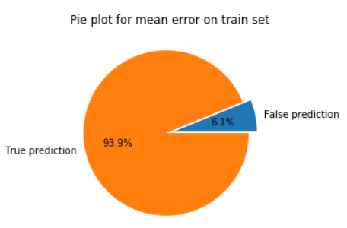
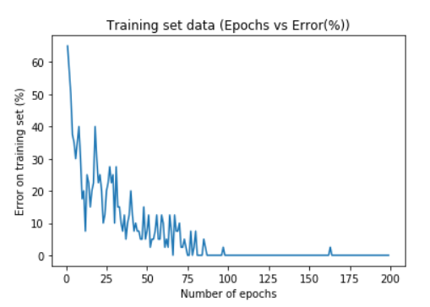
Type-1 CNN Architecture
MaxPool 2 X 1
Stride (2,1)
Conv1d 6 X 1, 128
Stride (1,1)
Conv1d 6 X 1, 128
Stride (1,1)
Conv1d 6 X 1, 128
Stride (1,1)
Dropout 0.5
MaxPool 4 X 1
Stride (4,1)
Conv1d 400 X 1, 64
Stride (50,1)
CNN Type-1 Architecture (Freq)

Slide 3
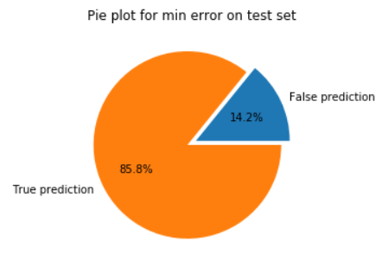
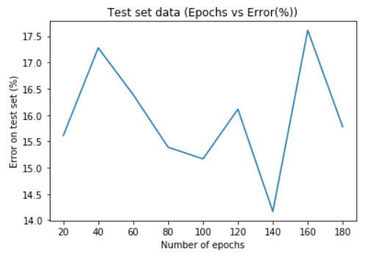
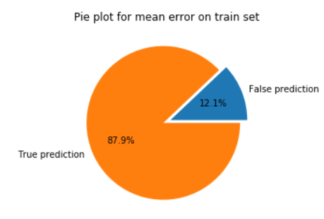
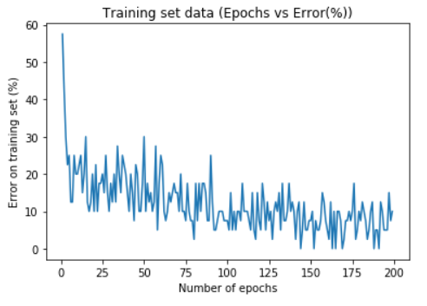
Type-2 CNN Architecture
MaxPool 4 X 1
Stride (4,1)
Conv1d 8 X 1, 128
Stride (1,1)
Conv1d 8 X 1, 128
Stride (1,1)
Conv1d 8 X 1, 128
Stride (1,1)
Dropout 0.5
MaxPool 8 X 1
Stride (8,1)
Conv1d 50 X 1, 64
Stride (6,1)
CNN Type-2 Architecture (Time)

Slide 4
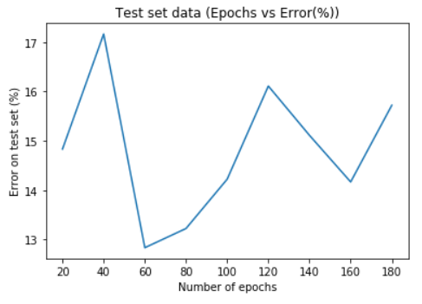
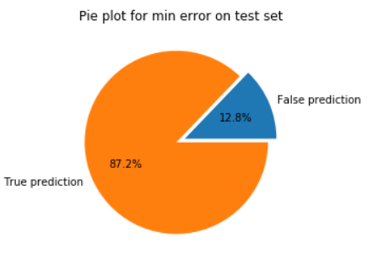
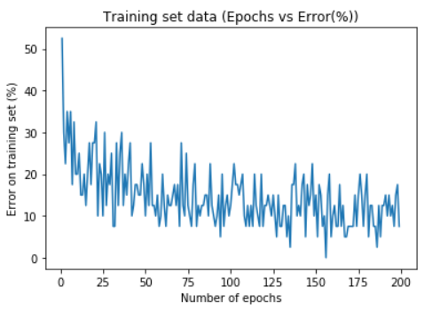
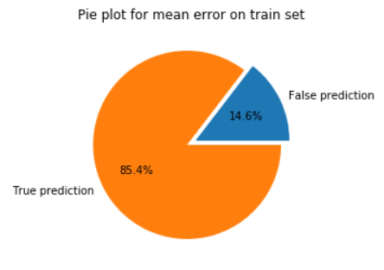
Concatenated CNN Architecture
Dropout 0.5
Concatenation
MaxPool 2 X 1
Stride (2,1)
MaxPool 4 X 1
Stride (4,1)
Conv1d 6 X 1, 128
Stride (1,1)
Conv1d 8 X 1, 128
Stride (1,1)
Conv1d 6 X 1, 128
Stride (1,1)
Conv1d 8 X 1, 128
Stride (1,1)
Conv1d 6 X 1, 128
Stride (1,1)
Conv1d 8 X 1, 128
Stride (1,1)
Dropout 0.5
Dropout 0.5
MaxPool 4 X 1
Stride (4,1)
MaxPool 8 X 1
Stride (8,1)
Conv1d 400 X 1, 64
Stride (50,1)
Conv1d 50 X 1, 64
Stride (6,1)
CNN Type-1 + Type-2 Architecture

